Slide 1

RNA-seq analysis of 6 cell types in regeneration muscle tissue between young and old mice
Partenariat des équipes de:
Dr. Fabien LE GRAND
Dr. Bénédicte CHAZAUD
Dr. Jérôme FEIGE
Contributeurs Principaux:
PhD Hoang DIEU-HUONG
IE Johanna GALVIS-LACROUX
IE William JARASSIER
IE Pauline MOULLÉ

Slide 2
Major Steps
downstream analysis
upstream analysis
Static analysis
Experimental design
Pretreatment data
Preliminary exploration data
Differential Experimental Genes
Gene Set Enrichment Analysis
Gene Tissues Specificity (tau)
Ligands Receptors Analysis
Dynamic analysis
Objectives: Find the pathways and genes differentially expressed between young and old
Represent the interactome of these changes

Slide 3
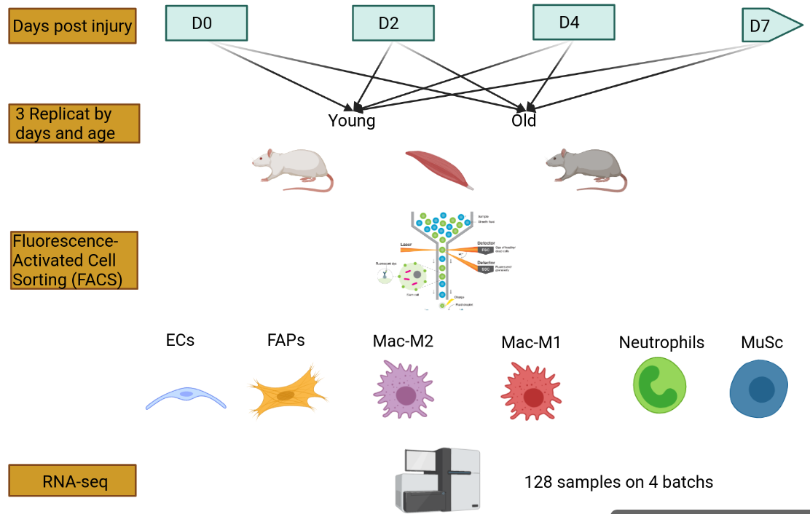
Experiment design
cardiotoxine
18 conditions
Cell sequenced | D0 | D2 | D4 | D7
ECs
FAPs
Mac-M1
Mac-M2
Neutrophils
MuSc

Slide 4
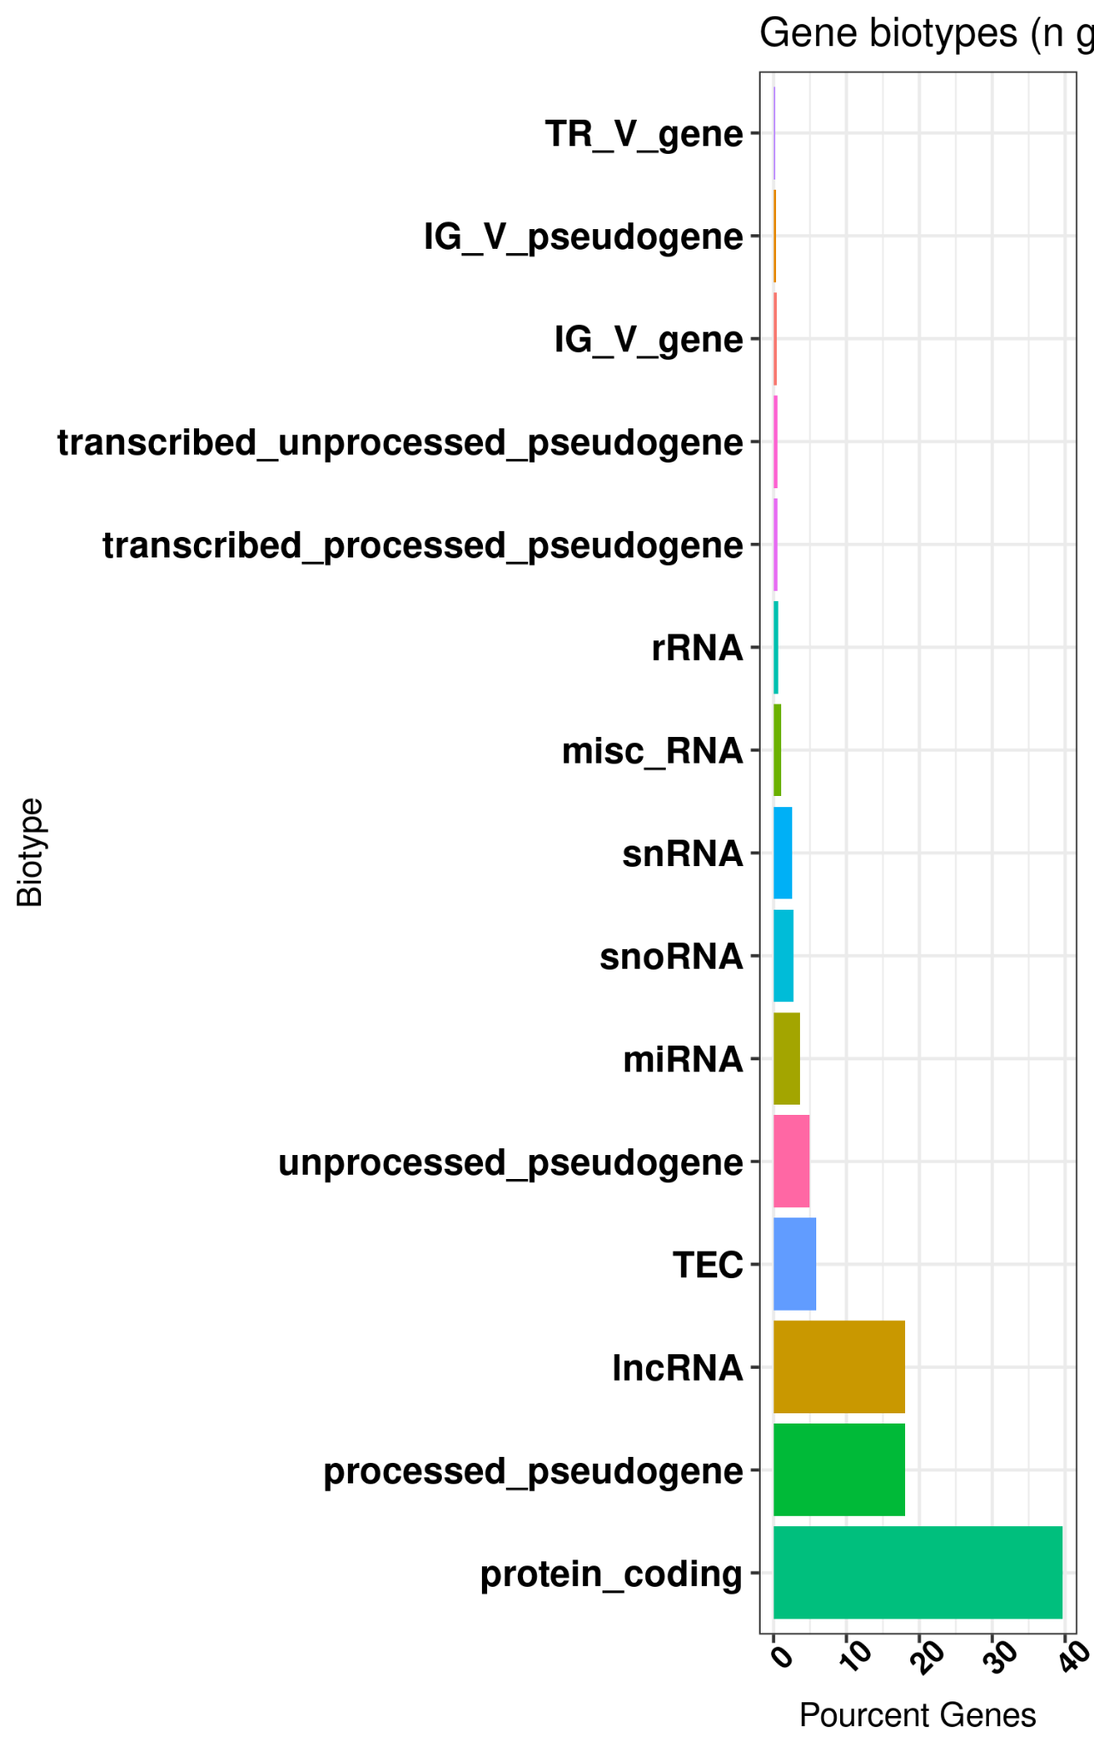
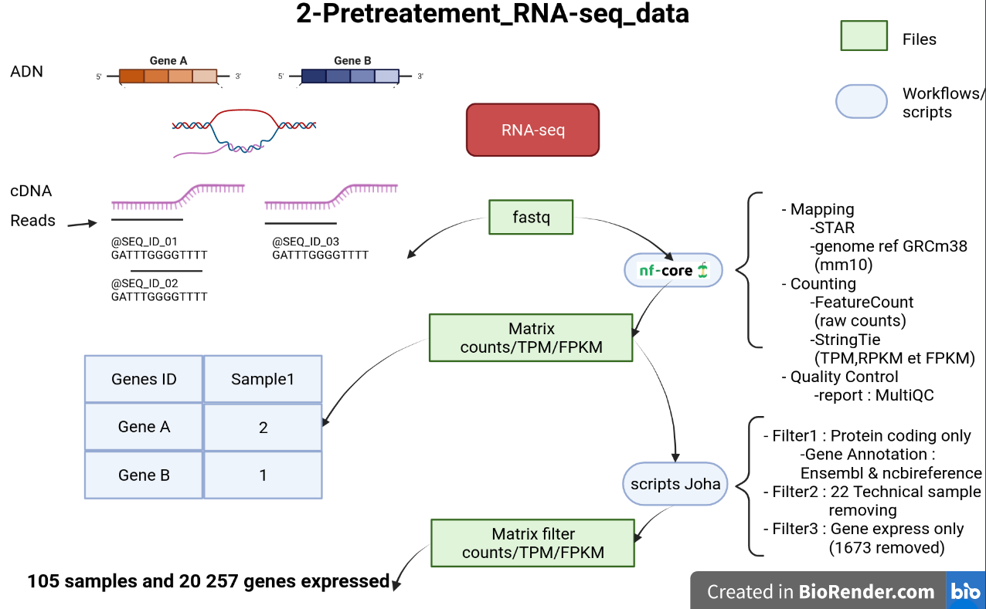
Pretreatment RNA-seq data
Filter1: Keep only 40% express gene
* Filter4: Genes associated with severals transcripts

Slide 5
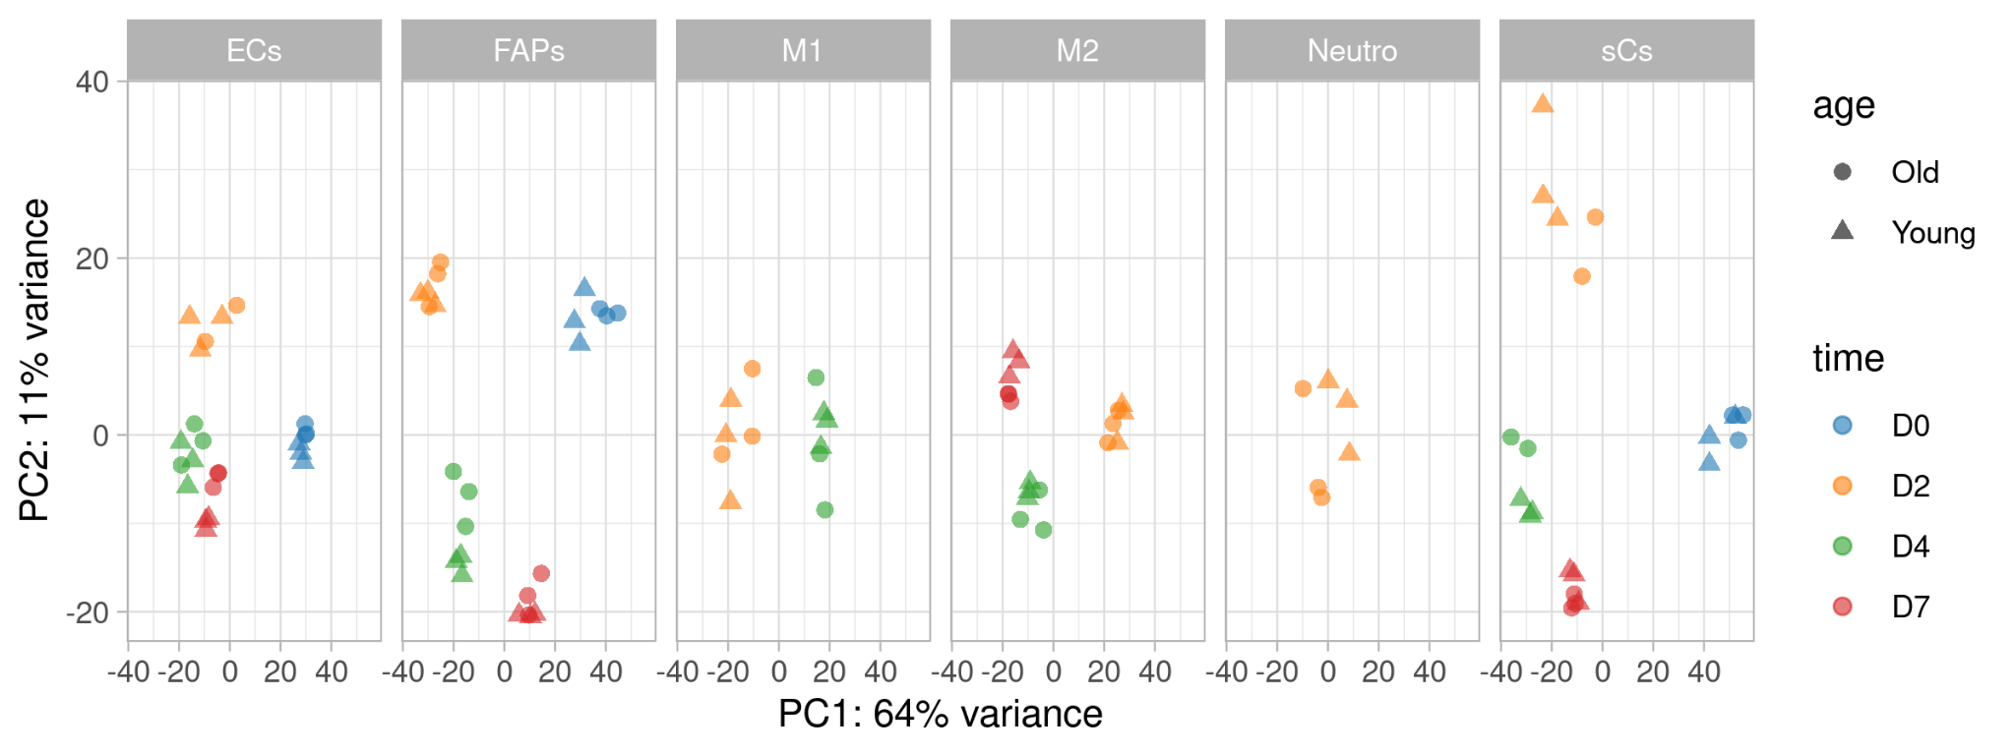
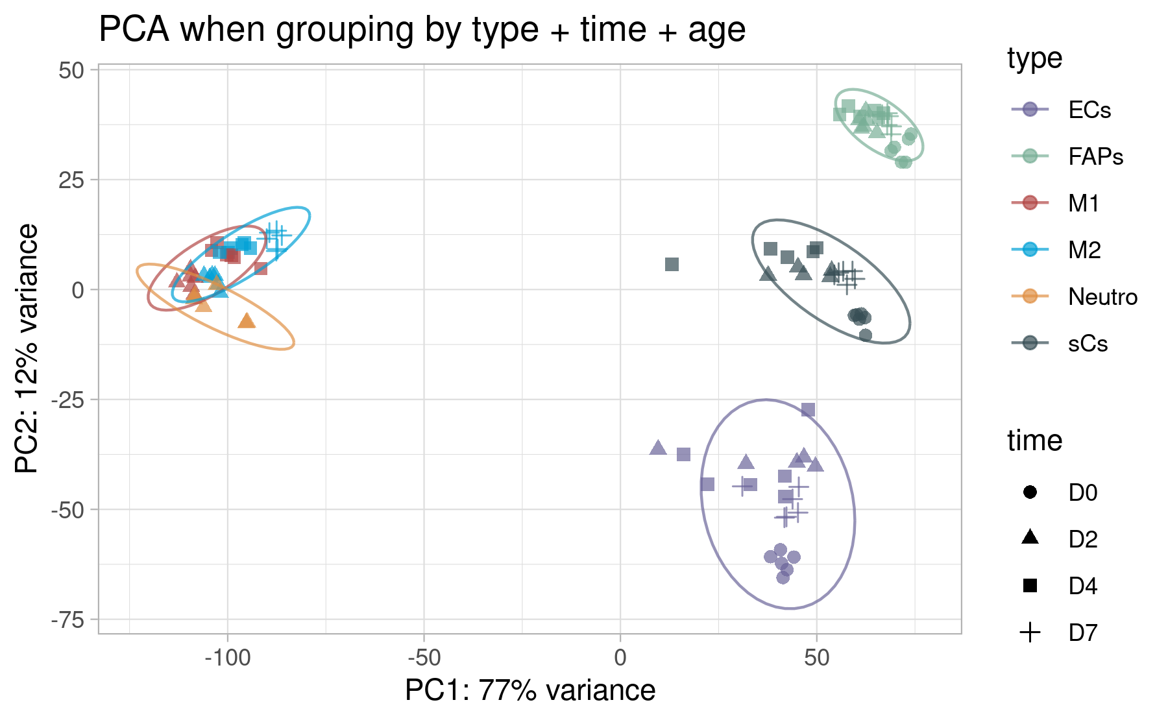
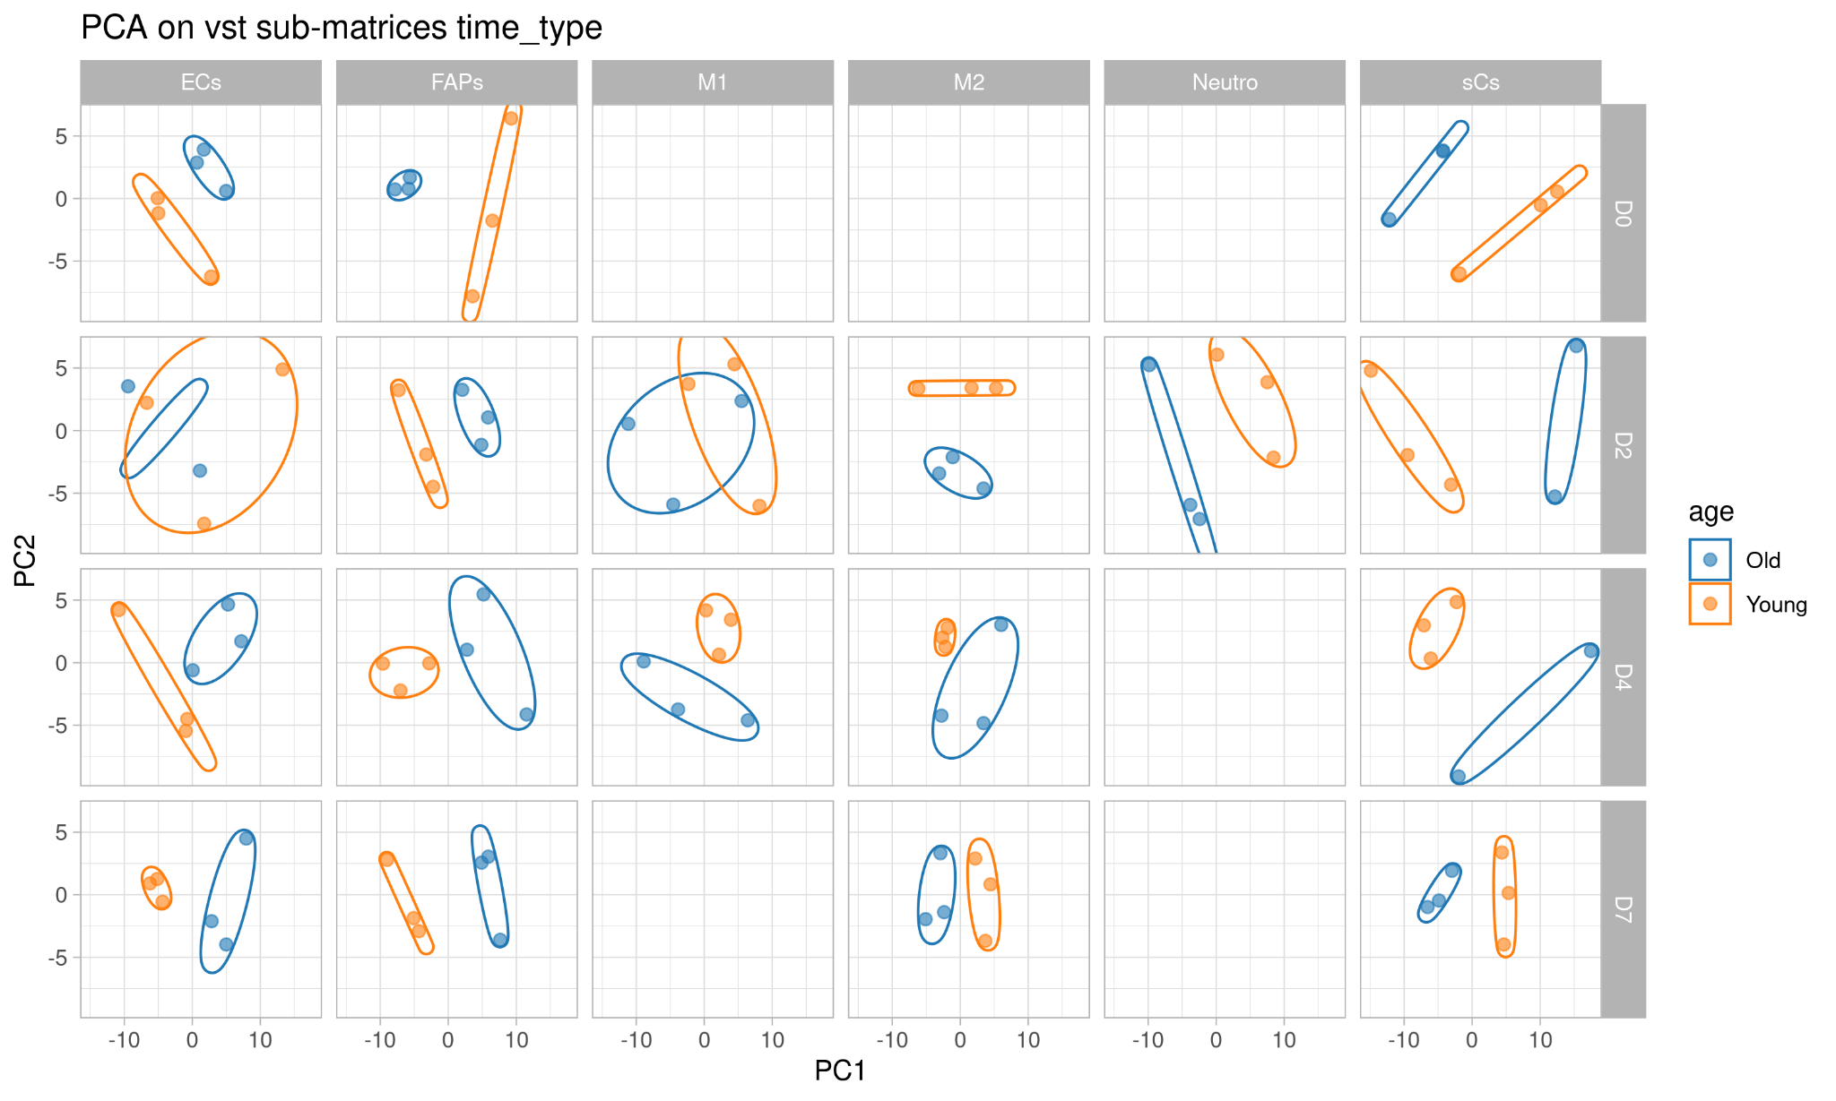
Preliminary exploration
PCA for each type of cell
Principal Component Analysis
PCA on all data frame
Expression grouping by days post injury
PCA for each type of cell and for each day post injury
Expression grouping by type cell
Expression slightly grouping by age

Slide 6
Major Steps
downstream analysis
upstream analysis
Static analysis
Experimental design
Pretreatment data
Preliminary exploration data
Differential Expressed Genes
Gene Set Enrichment Analysis
Gene Tissues Specificity (tau)
Ligands Receptors Analysis
Dynamic analysis
Differential expression between 2 time points:
Cell sequenced | D0 | D2 | D4 | D7
Ecs
FAPs
Mac-M1
Mac-M2
Neutrophils
MuSc

Slide 7
Major Steps
downstream analysis
upstream analysis
Static analysis
Experimental design
Pretreatment data
Preliminary exploration data
Differential Expressed Genes
Gene Set Enrichment Analysis
Gene Tissues Specificity (tau)
Ligands Receptors Analysis
Dynamic analysis
Axis of analysis
Young vs Old
Cell type:
Endothelial Cell - ECs
Neutrophils
Muscle Stem Cell - MuSCs
Days post injury : D0, D2, D4 et D7
Macrophage 1 - Mac_M1
Macrophage 2 - Mac_M2
FibroAdipogenic Progenitors - FAPs

Slide 8
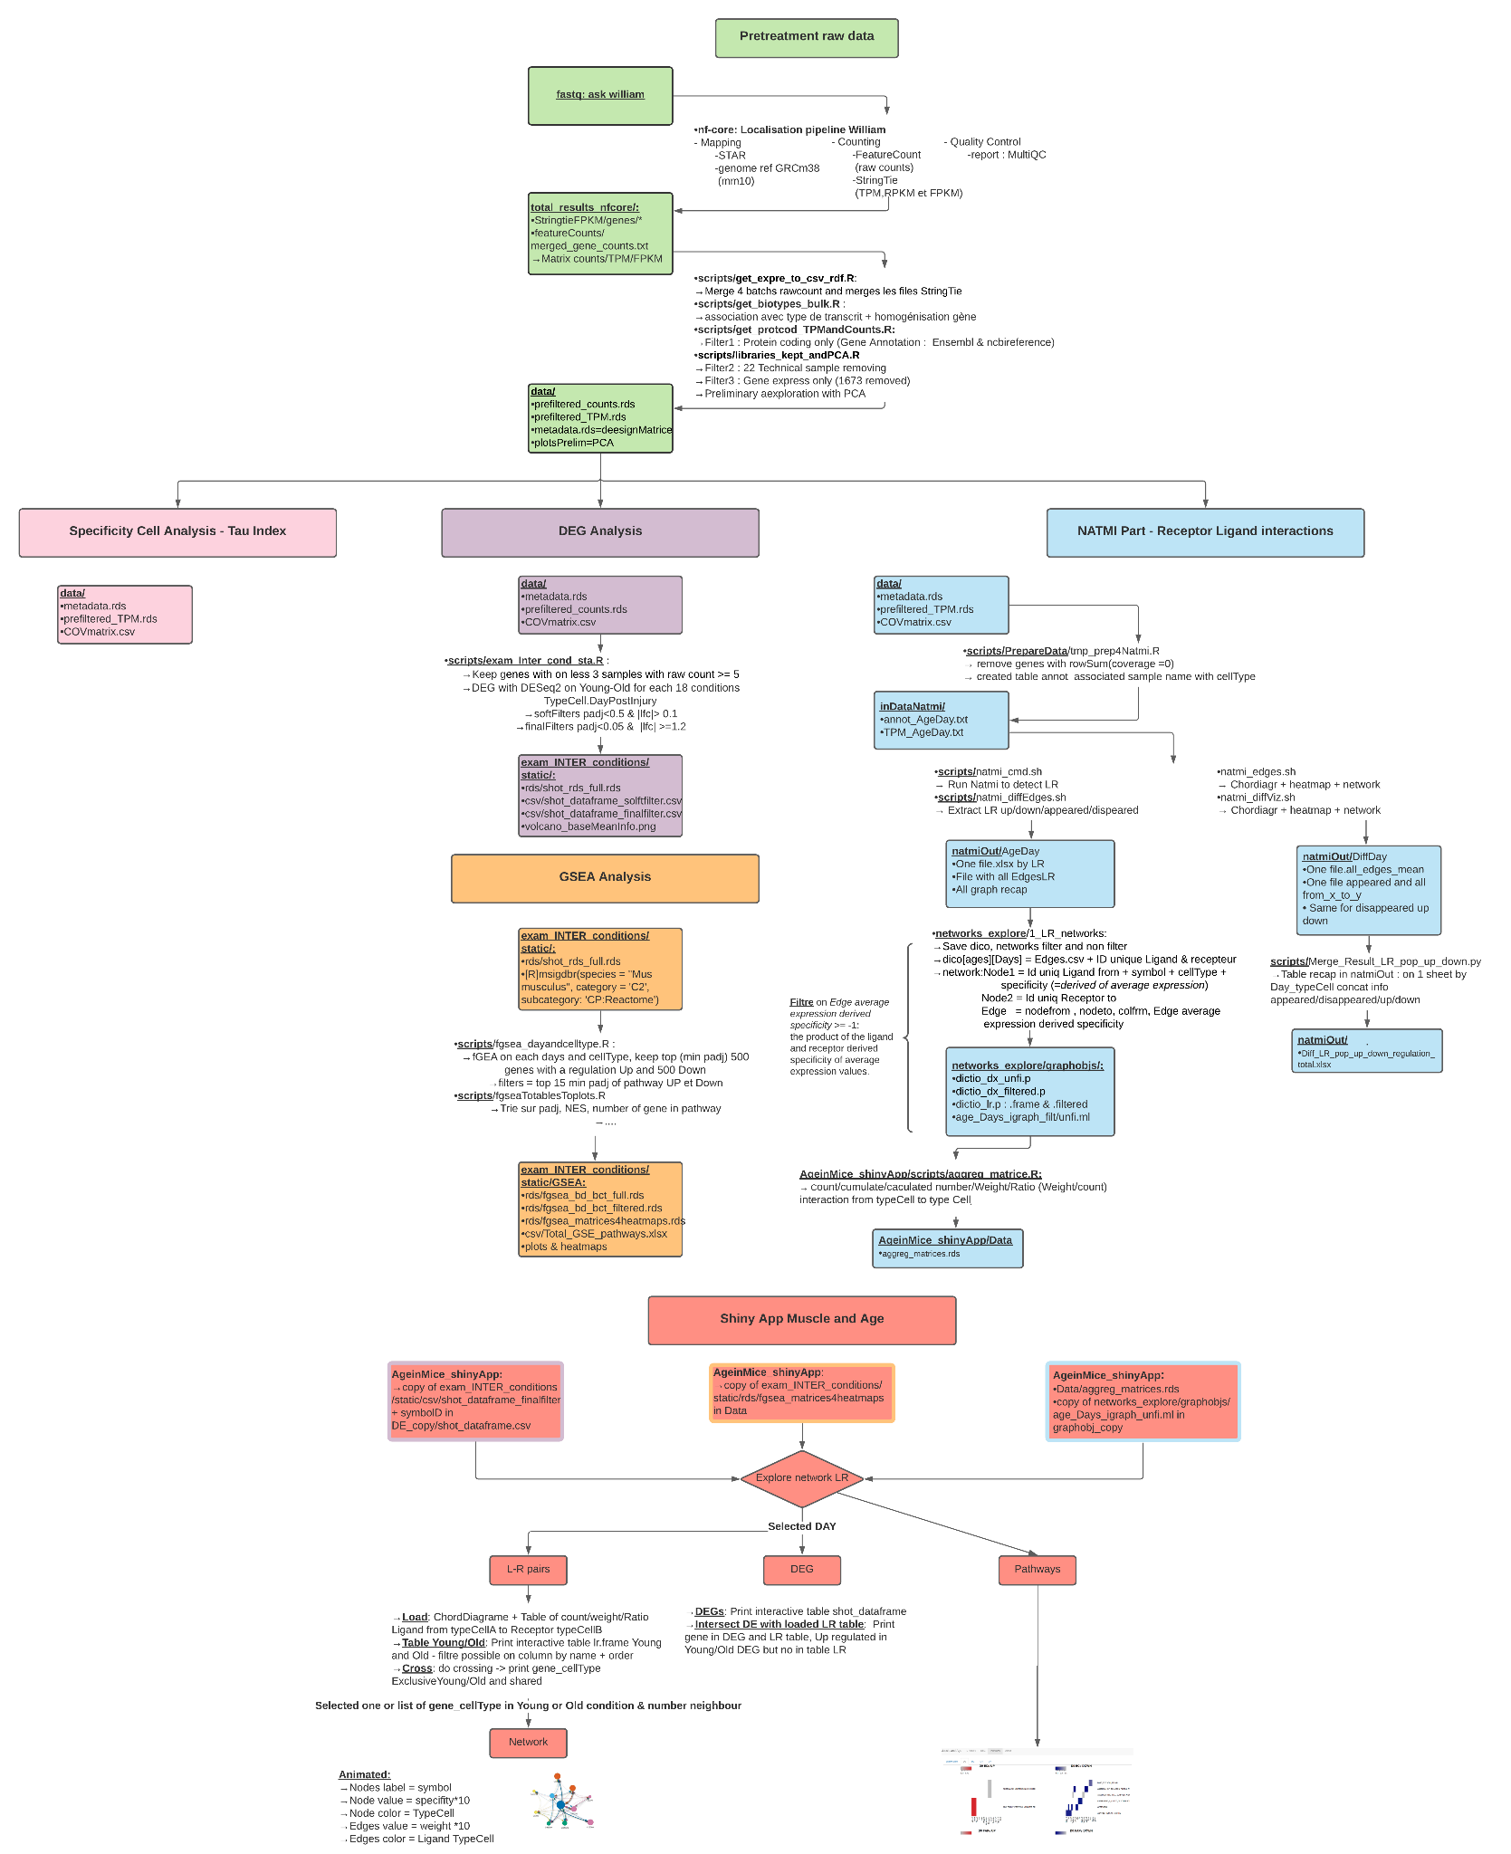

Slide 12
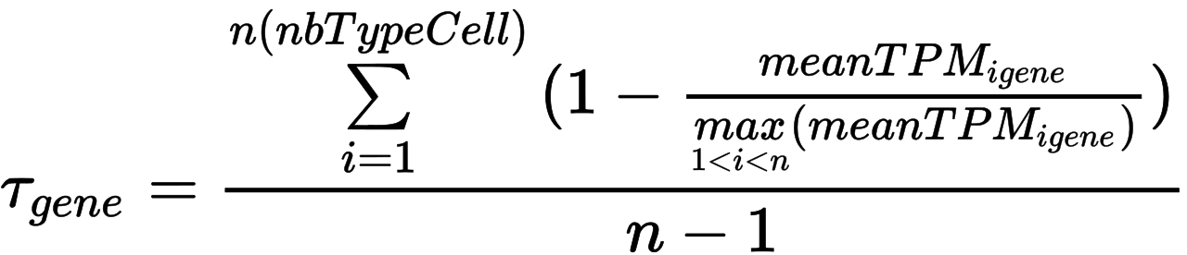
Gene specificity to a type cell
Calculate Tau Specificity
Index de spécificité Tau (τ ) calculate for each gene at a condition chosen age +Day postInjury :
Table resultat:
GeneID | GeneSymbol | τ | Classification | whichMAX | nbMAX | maxlog10TPM | AgeDay
Gene classification:
Tau >= 0.8 ~ specific
0.5 <=Tau < 0.8 ~ intermediate,
Tau < 0.5 ~ housekeeping
Keep the cell type the more expressed
If equality, keep the 2 types

Slide 13
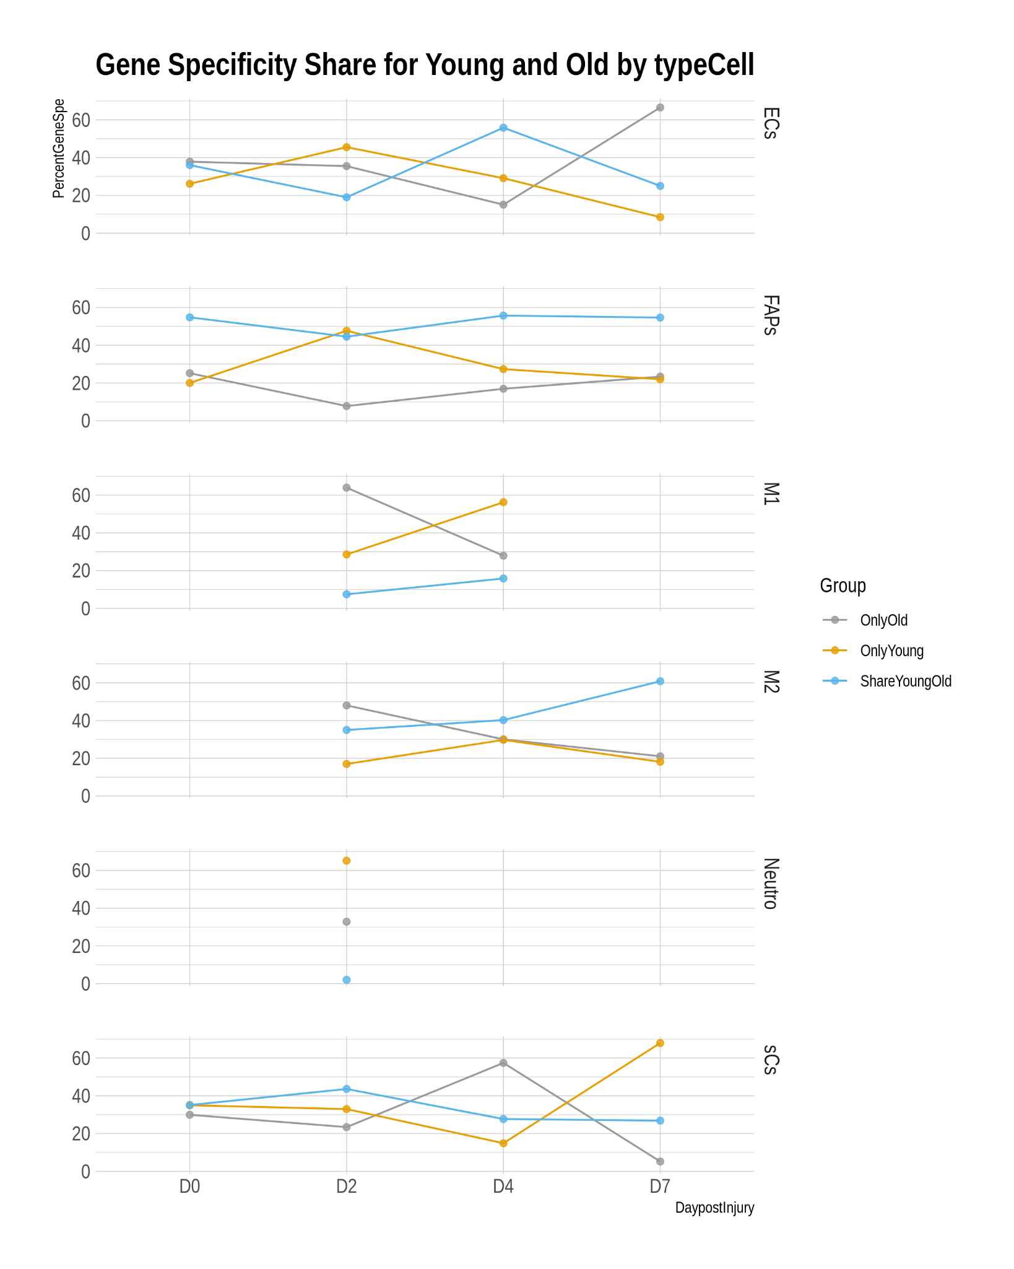
Gene specificity to a type cell
Without DEG analyse , the gene specificity dynamique change in young and old condition

Slide 14
Gene specificity to a type cell
Are the specific genes in young condition the same as in old condition?
Without DEG analyse , the gene specificity dynamique change in young and old condition

Slide 15
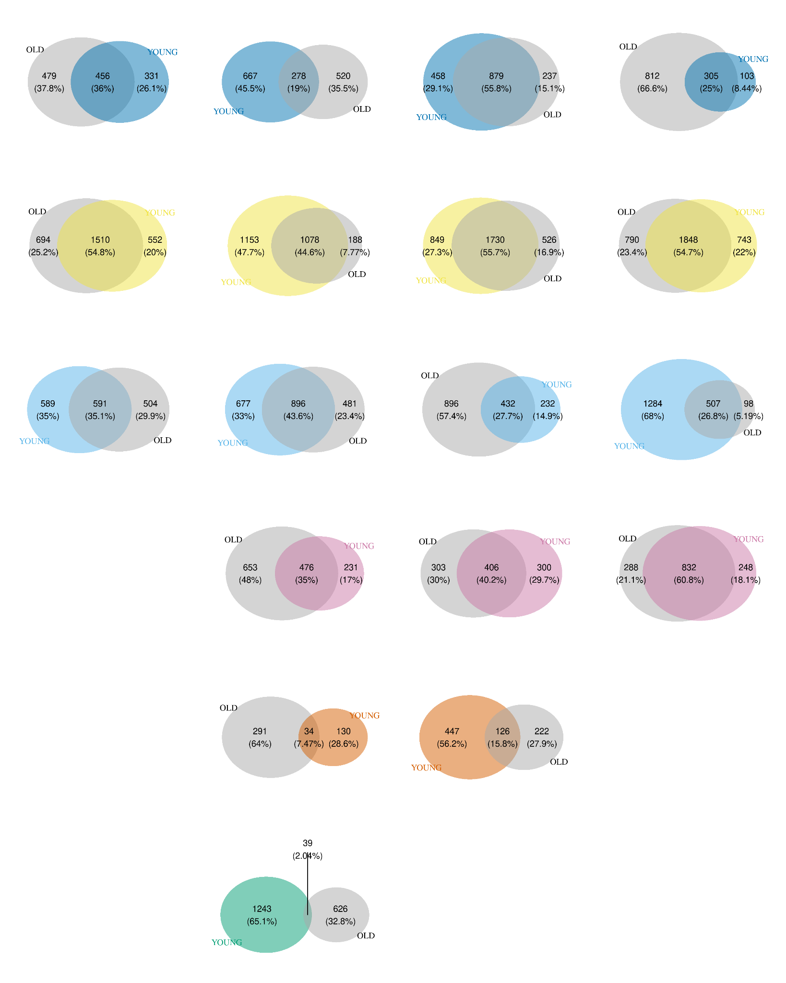
Gene specificity to a type cell
D2 D4
Mac-M1
What is maybe interesting ?
Genes where the specificity changes between Y-O
Genes where the
D4 D7
MuSCs

Slide 16
Differential Expressed Genes (DEG)
On gene with on less 3 samples with raw count >= 5 (2 460 gene remove)
DEG Old-Young for each 18 conditions TypeCell.DayPostInjury
25% genes are padj<0.05 on less one condition

Slide 17
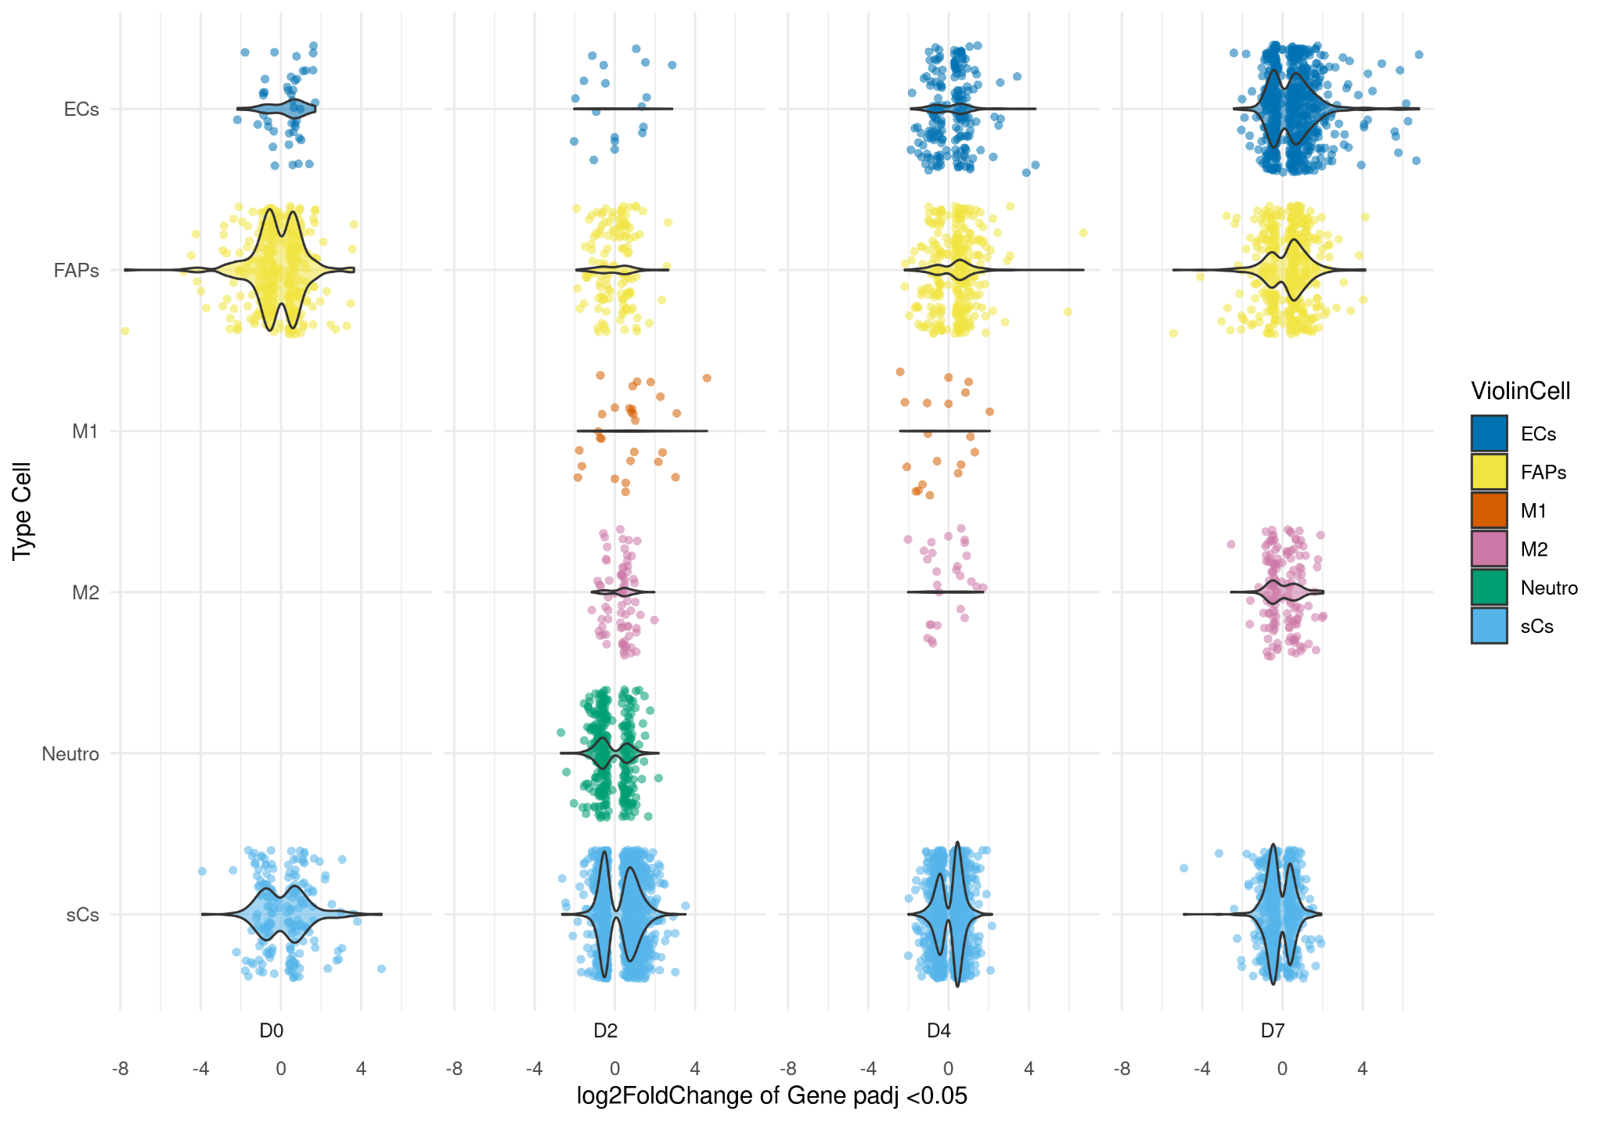
Differential Expressed Genes (DEG)
 | ECs | FAPs | sCs | M1 | M2 | Neutro
D0 | 1.6 | 8.7 | 8.1 | NA | NA | NA
D2 | 1.0 | 4.0 | 32.3 | 0.5 | 1.6 | 5.3
D4 | 4.7 | 6.6 | 23.4 | 0.3 | 0.6 | NA
D7 | 10.4 | 7.0 | 10.1 | NA | 2.4 | NA

Slide 18
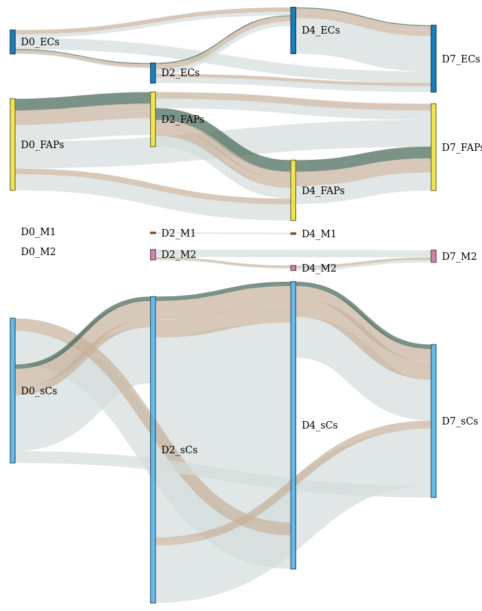
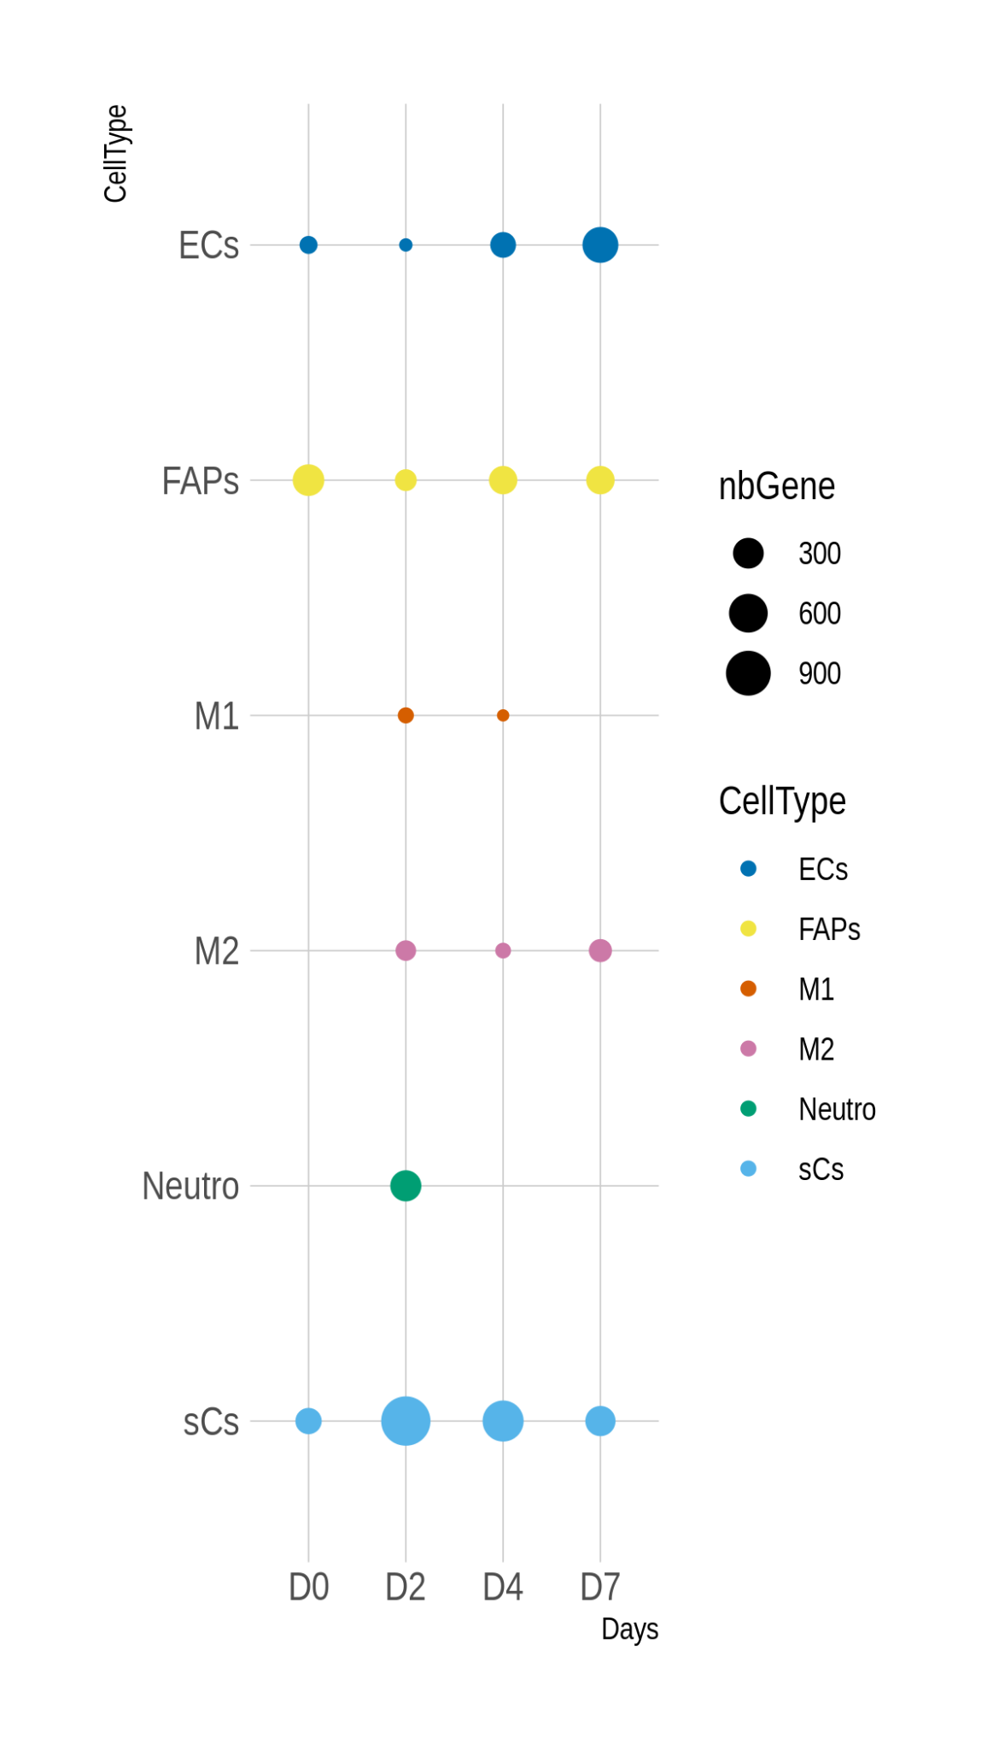
Number Genes DE Young-Old on a TypeCell only on more of one Day
Number Genes DE Young-Old on a TypeCell only on one Day
Genes DE on
2 conditions
3 conditions
4 conditions
Nb Genes :
84
38
24
file:///home/bioinfo/BulkAnalysis_plusNetwork/scripreportHTMLts/GeneDEsigniOnMoreOneTimePoint.html
Notes:
tendance

Slide 19
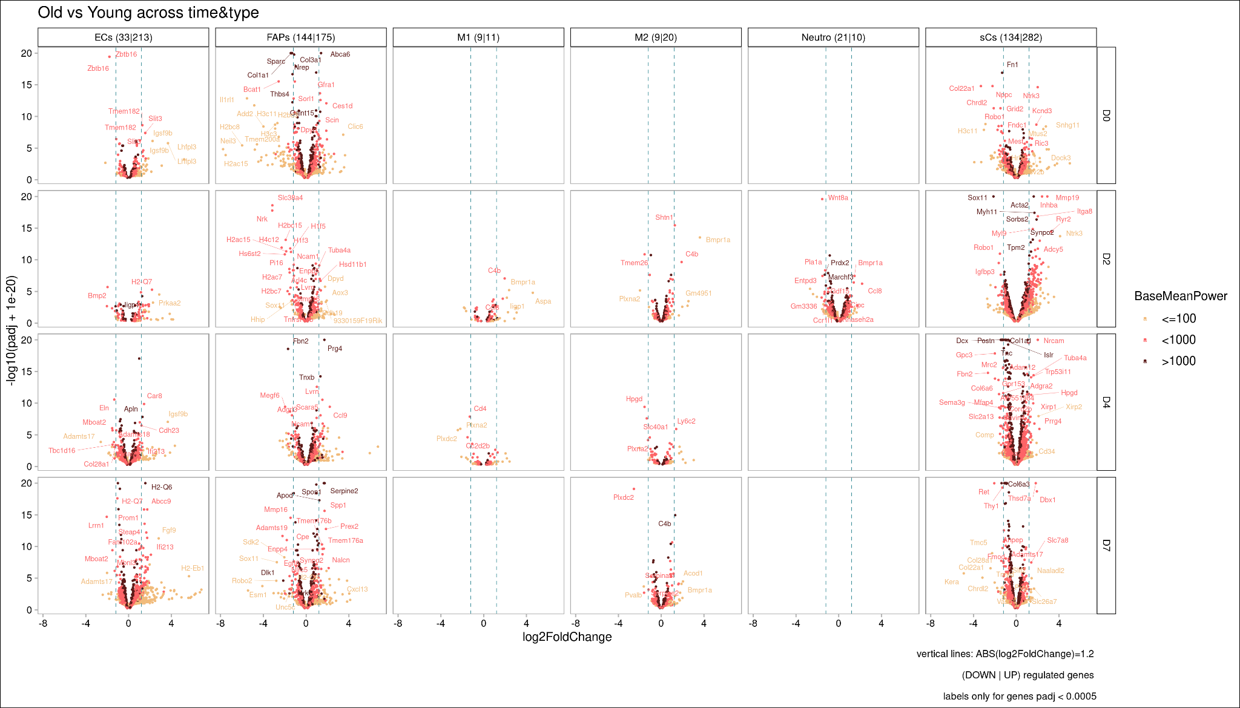
Differential Expressed Genes (DEG)

Slide 20
II. Genes Set Enrichment Analysis (GSEA)
Before
Algorithme : fGEA use in R
Database:
Genes Set from Molecular Signatures Database (MSigDB) species :
species = Mus musculus
category C2 = online pathway databases and the biomedical literature
subcategory = Canonical pathways ,Reactome database
On each days and cellType
On top (min padj) 500 genes with a regulation Up and 500 Down
Sort by log2FoldChange
2. Now
On each days and cellType
On “all” genes
Sort by signed of log2FoldChange * - log10(padj)
Approx 3 000 genes with padj = NA

Slide 21
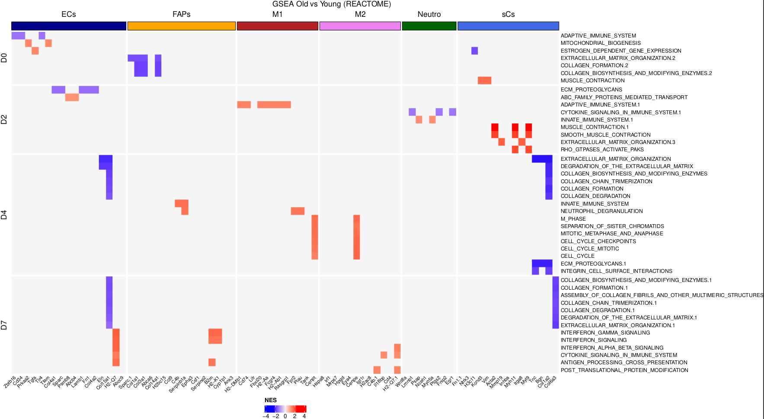
II. Genes Set Enrichment Analysis (GSEA)
Notes:
NES > 0 ( padj top 15 )
NES < 0 ( padj top 15 )
=540
exclude pathway DISEASE-DEVELOPMENT-INFECTION
-28
suppression pathways trop spécific -> ceux avec moins de 5 genes
=243 dont 134 unique
et 1154 genes
par jour et type cel on garde seulement le min top 10 genespadj + abs(logFoldchange >= 0.3
garde seulement les pathway dont il reste au moins 2 genes

Slide 22
II. Genes Set Enrichment Analysis (GSEA)
file:///home/bioinfo/BulkAnalysis_plusNetwork/reportHTML/fgseaReport.html
Notes:
NES > 0 ( padj top 15 )
NES < 0 ( padj top 15 )
=540
exclude pathway DISEASE-DEVELOPMENT-INFECTION
-28
suppression pathways trop spécific -> ceux avec moins de 5 genes
=243 dont 134 unique
et 1154 genes
par jour et type cel on garde seulement le min top 10 genespadj + abs(logFoldchange >= 0.3
garde seulement les pathway dont il reste au moins 2 genes

Slide 23
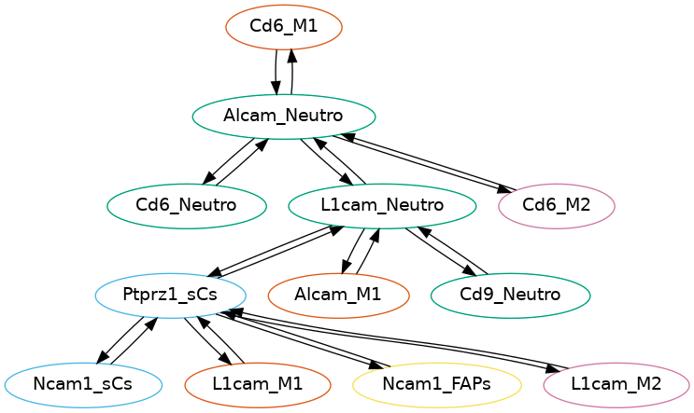
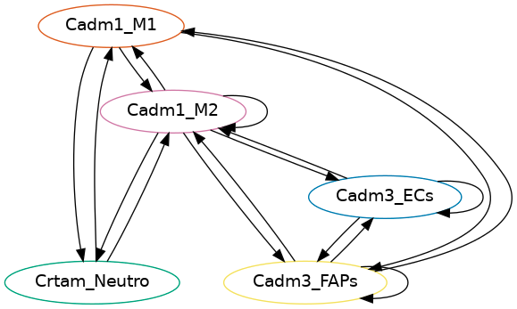
NATMI Network Analysis Toolkit for Multicellular Interaction
Base on expression table (TPM) and database Ligand Receptor ConnectomeDB2020 :
Calc specificity of Ligand and Receptor
Edge weight = specificity Ligand * specificity Receptor
Représentation des réseaux: des graphes orientés pondérés
μ=14 « composantes connexes »
(taille <= 12)

Slide 24
Bilan Static Analysis
Each gene has the following information for each DaysPostInjury and TypeCell:
Expression intensity for Old and Young:
Raw count
TPM ( mean replicat TPM) ( Normalization by length gene and depth )
DEG Young vs Old:
False Discovery Rate (FDR) with -> padj
Intensity and sense of DEG with -> log2FoldChange
Pathways which it is imply :
False Discovery Rate (FDR) with -> padj
((Intensity and sense of regulation of pathway with -> log2FoldChange))
Sensibility at a type of cell
Tau
Implication on a interaction Receptor Ligands

Slide 25
Objectives
Created a central table with majors informations and the keys access to all specifics info locate in small table
For each genes DEG on less one
◆ Number Specific & intermediate ◆ Days ◆ Type Cell ◆ NumberOnlyYoung/Old/Share ◆ Code trends O&Y
Illustrating trends and try to cross trends
Exploration of dataset with shiny app
Central table with filters -> allow to select a gene
Visualisation of his network for Old and Young conditions
Find a way to remove the 2 networks to highlight the differences
◆ Number of conditions DEG (padj<0.05) ◆ Days ◆ Type Cell ◆ Code_illustrating trends ex:FAPs_1011
◆ Number of Gene Set Enrichment (padj<0.05) ◆ Days ◆ Type Cell ◆ Code_illustrating trends ex:FAPs_Up0DownUp
◆ Number of Interaction Receptor Ligand ◆ Days ◆ Type Cell ◆ NumberOnlyYoung/Old/Share ◆ Code trends O&Y

Slide 26
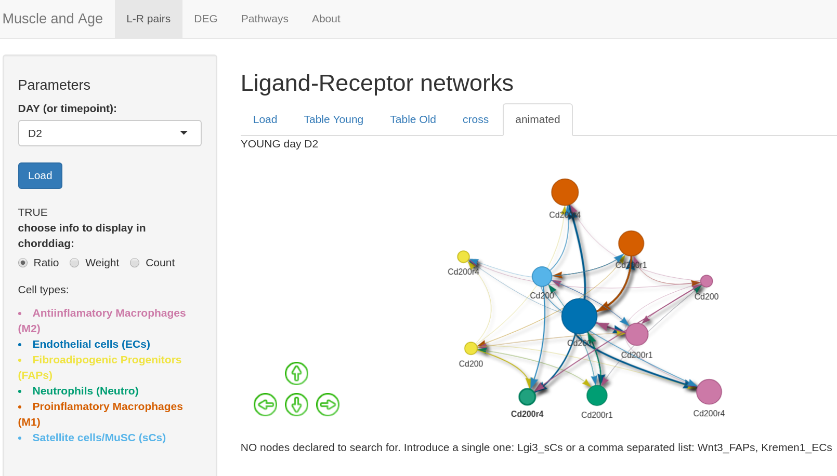
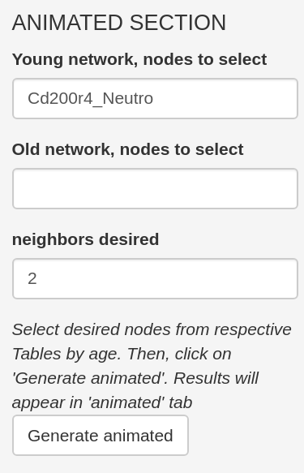
Objectives
Shiny Application to explore datas

